Slide 1
Jdm Cars Showcase
Automatically generated AI presentation

Slide 2
Contents
1. Introduction
2. Highlights
3. Images
4. Summary

Slide 3
What is Jdm Cars?
This presentation explores the theme 'jdm cars', as identified from the uploaded images.

Slide 4
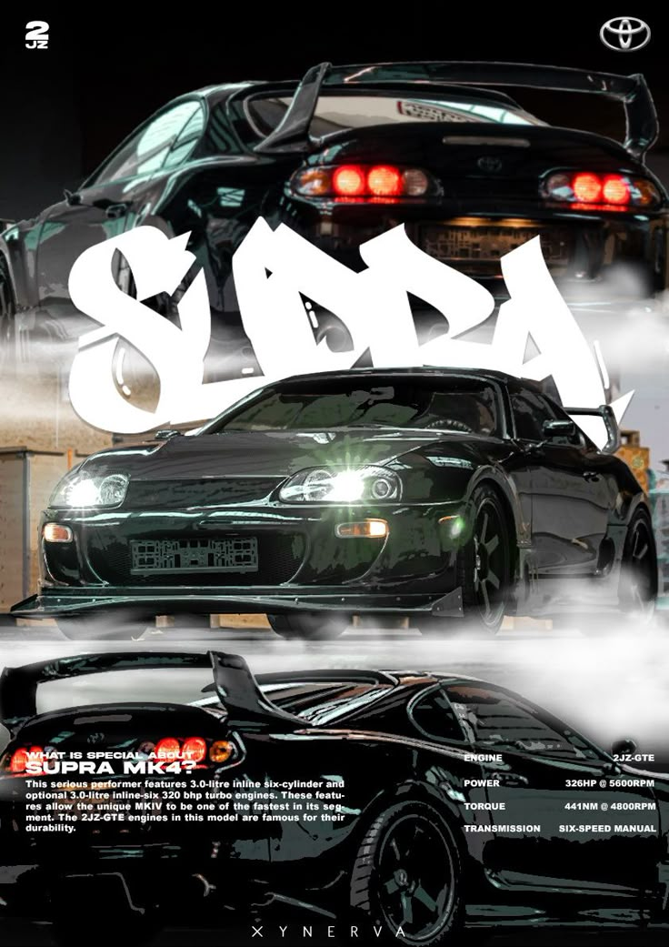

Slide 5
Summary
The common theme detected was: 'jdm cars'.
We hope this presentation gave a good insight!

Slide 6
Thank You!
Generated by SlideGen AI.

